Slide 1
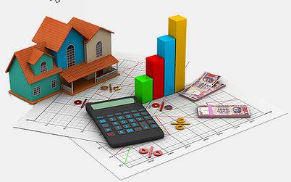


Image Processing Approach for House Price Estimation Allen Ansari
Data Science Intensive Capstone Project, Sep 2020 Cohort
Thanks to Springboard Mentor
Blake Arensdorf, Amazon

Slide 2
Outline
The problem
Who might care?
Factors affecting house price
Data Information
Data Wrangling
Data Exploration
Modeling
conclusion

Slide 3


The Problem
More than 90% of home buyers search online
Online website like Zillow using house characteristics to estimate price
Impact of interior and exterior appearance not consider

Slide 4





Who might care?
Zillow uses 110 million homes characteristics
Redfin estimating 40 million homes using 500 data point for each
Median error 7.9%
Median error 1.82%

Slide 5

Factors affecting house price
Location
Local Market
Size
Economy
Upgrades
Interest Rate
Age & Condition
What About Images?

Slide 6
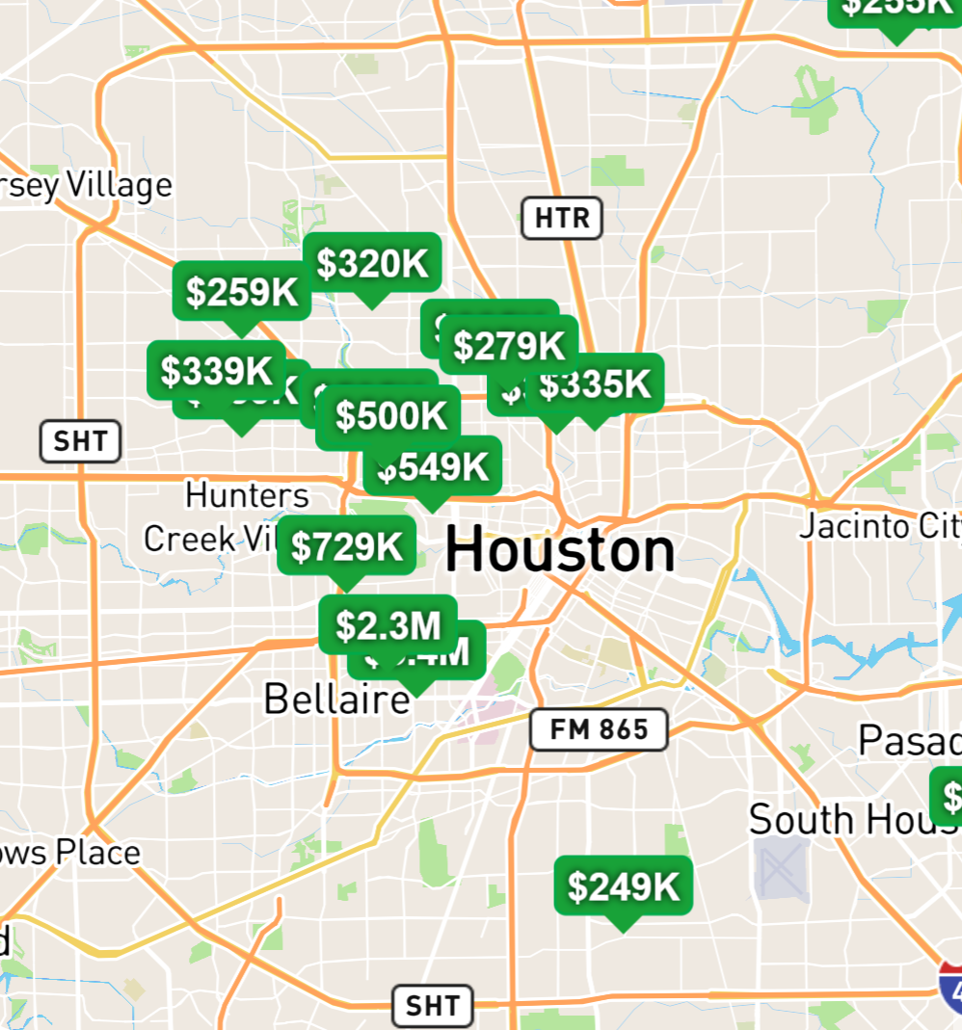
Data Information
108 Houston zip codes
Over 15K house information scraped
99 features like Address, subdivision, bathroom, built year etc.
Images posted (range between 2 to 95)

Slide 7
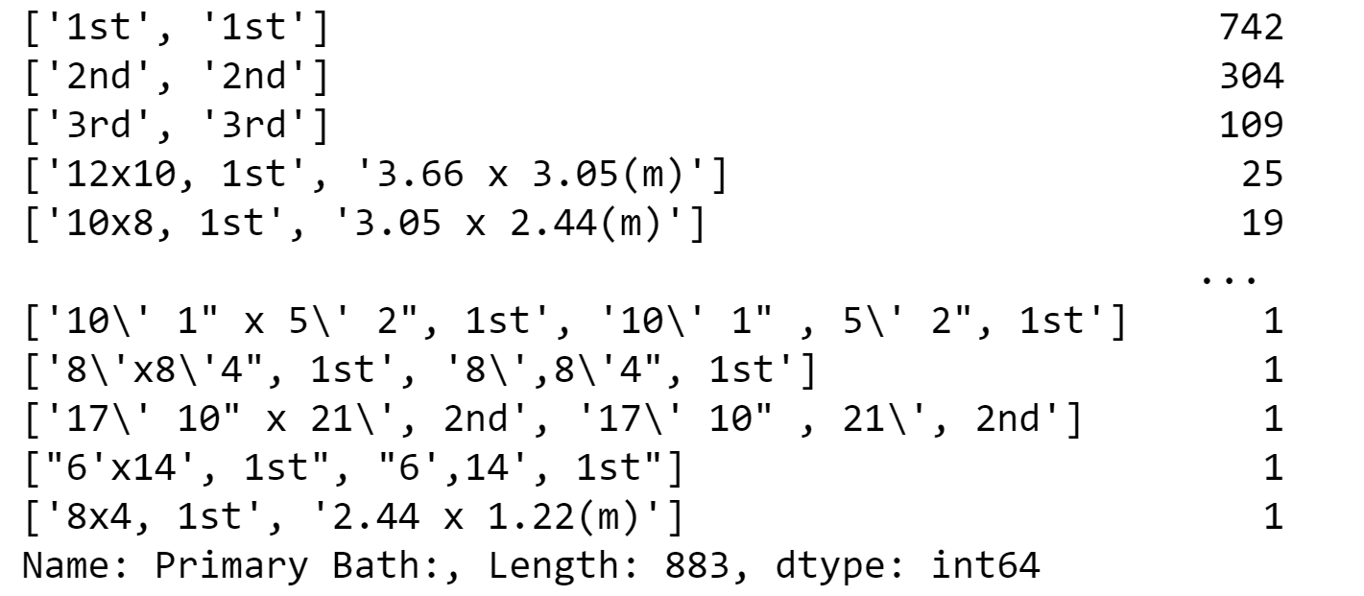
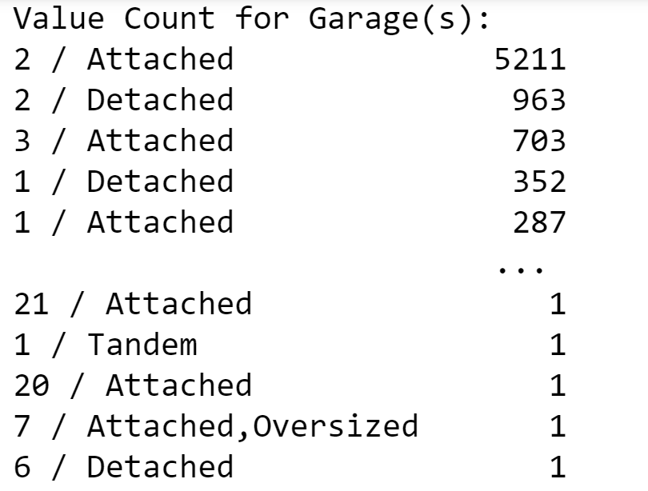
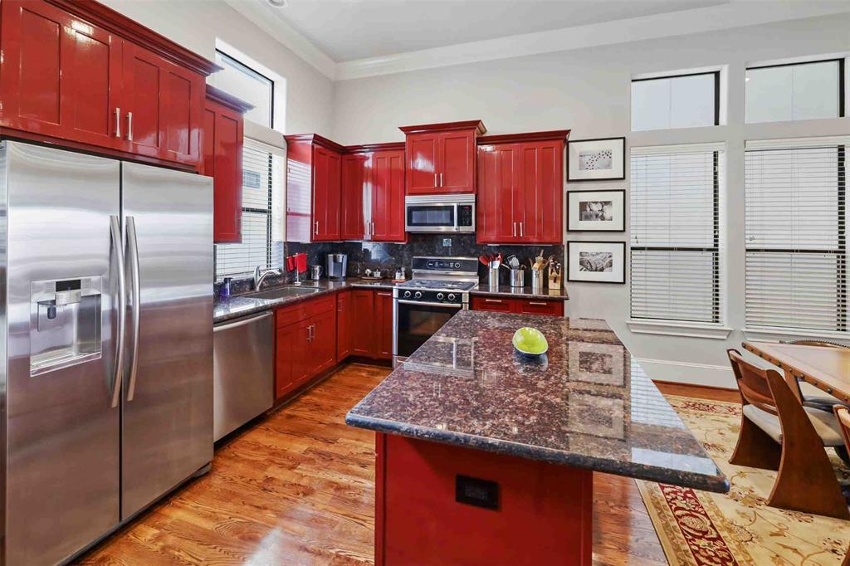
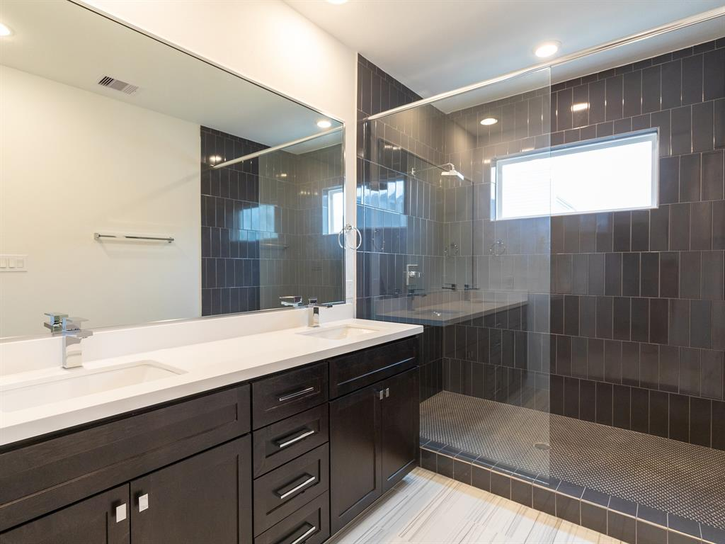
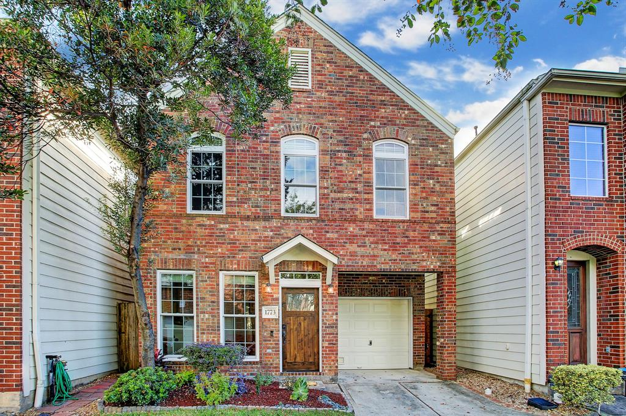
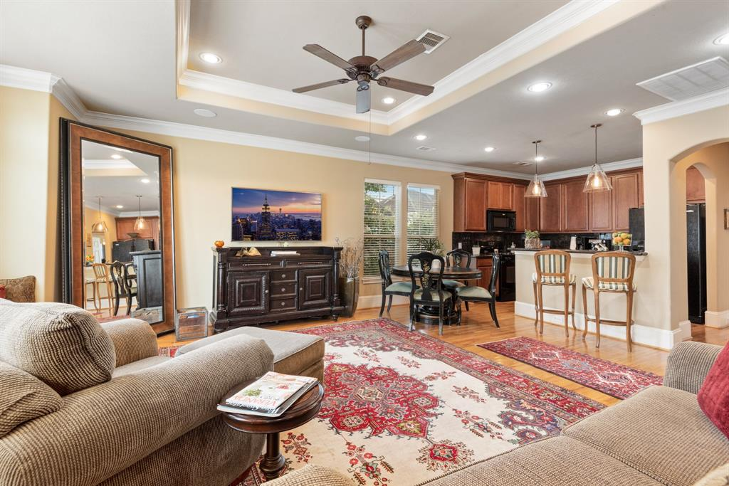
Data Wrangling
Only Single Home type
Data entered in different formats
Typo mistakes
Filling NAs with subdivision medians
6348 rows × 50 columns
Over 205K images

Slide 8
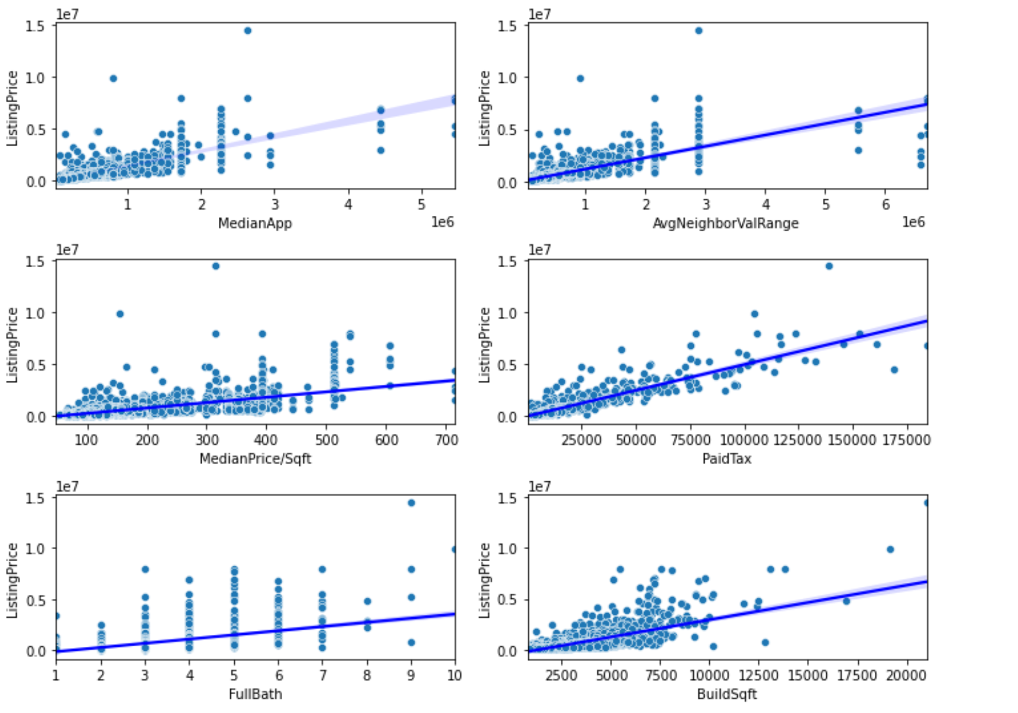
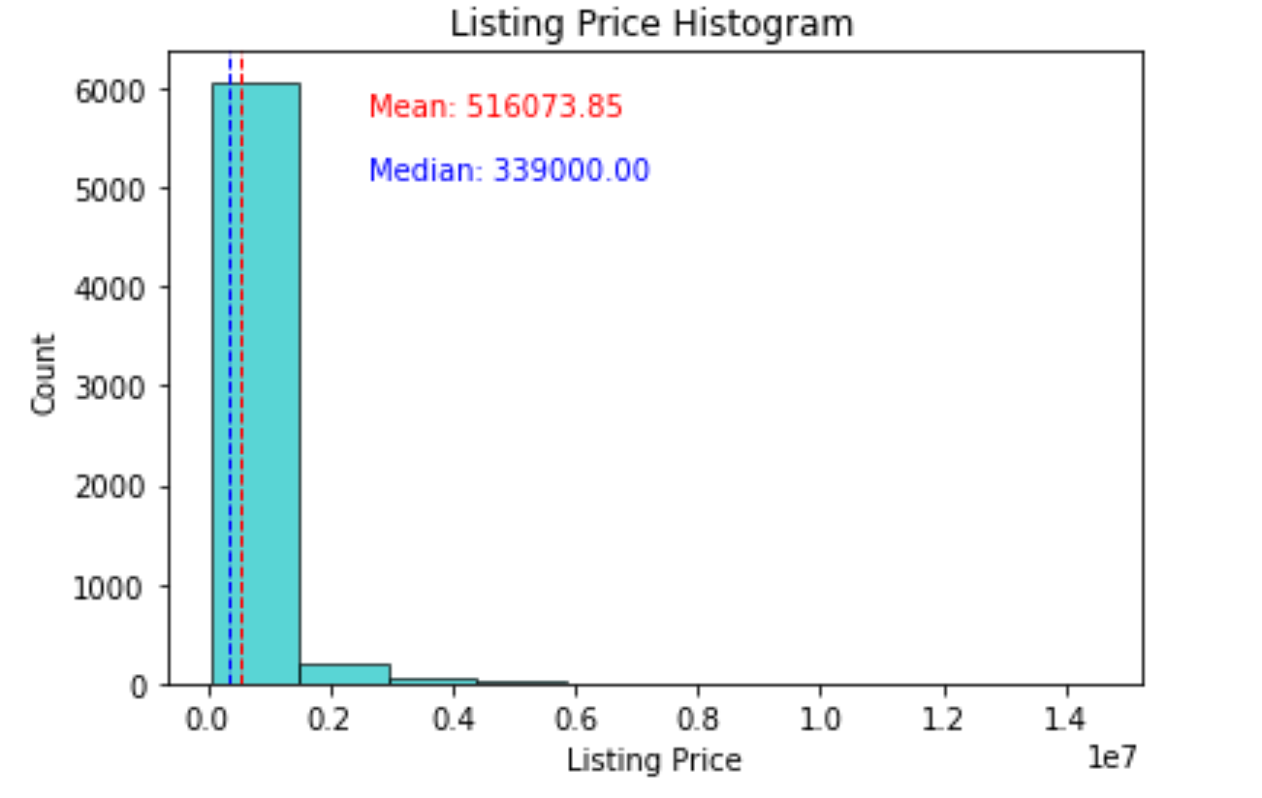
Data Exploration

Slide 9
Modeling
House Information Model
Image classification
Regression model using CNN
Ensemble Model

Slide 10
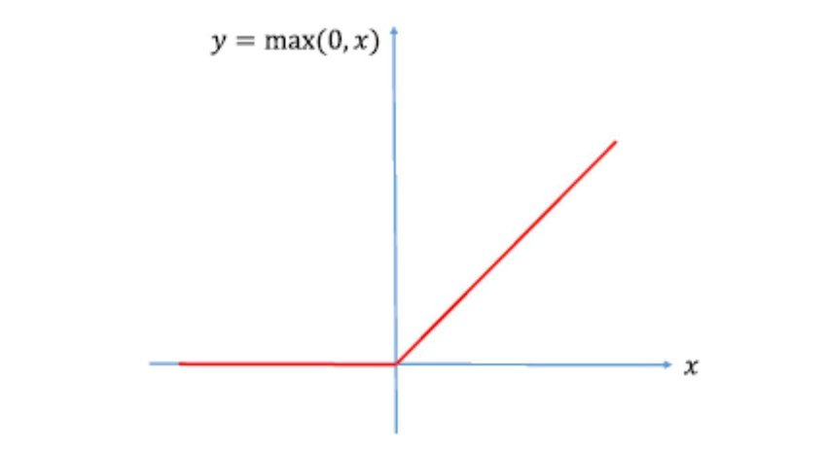
House Characteristics Model
Min Max Scalar
Binary Encoder
Lot Size
MLP
Building Sqft
living Sqft
kitchen Sqft
No. of Garage
Median Error 9.95%
Median Absolute Error $34,194

Slide 11
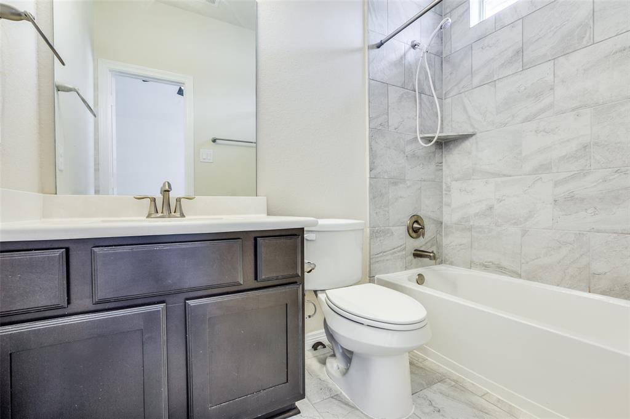
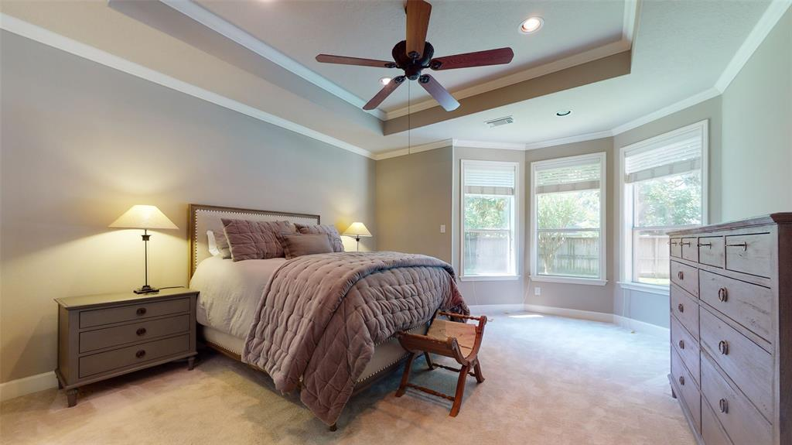
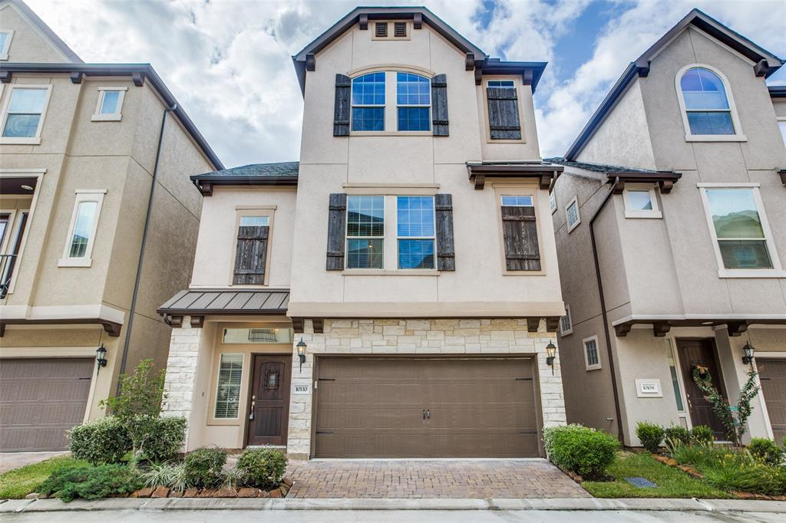
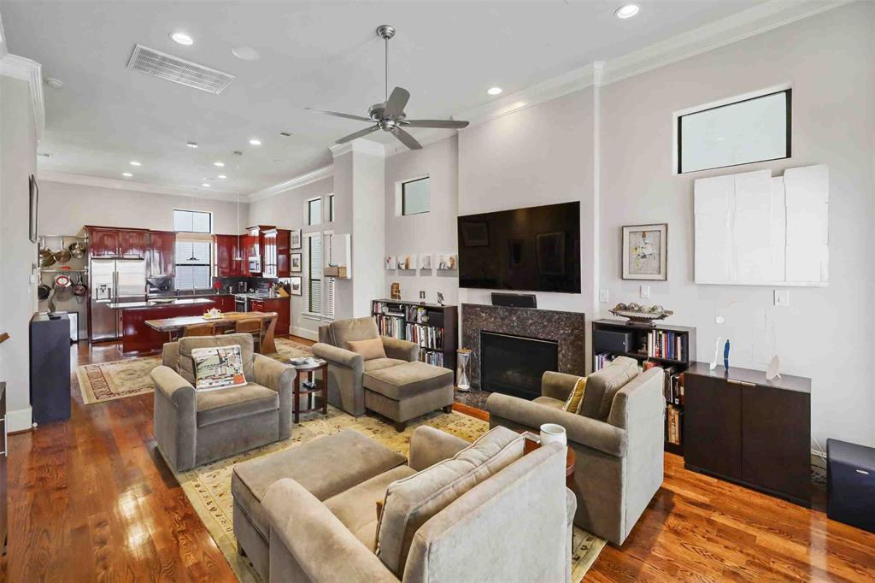
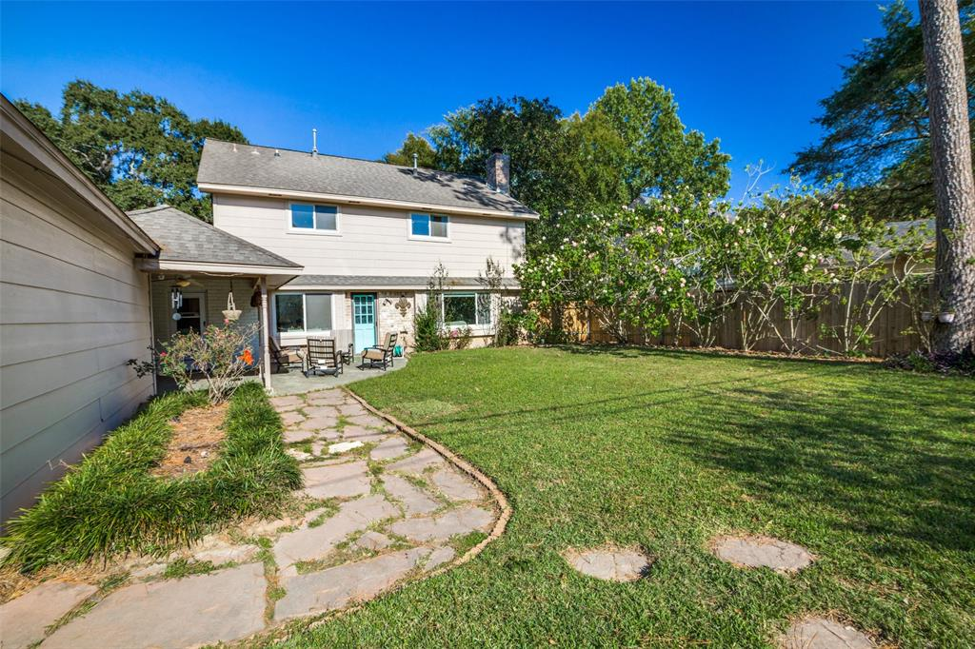
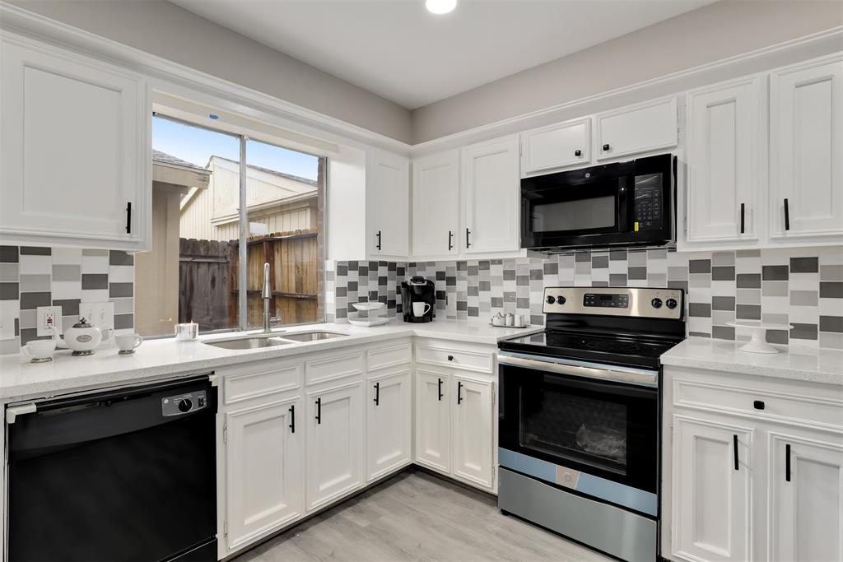
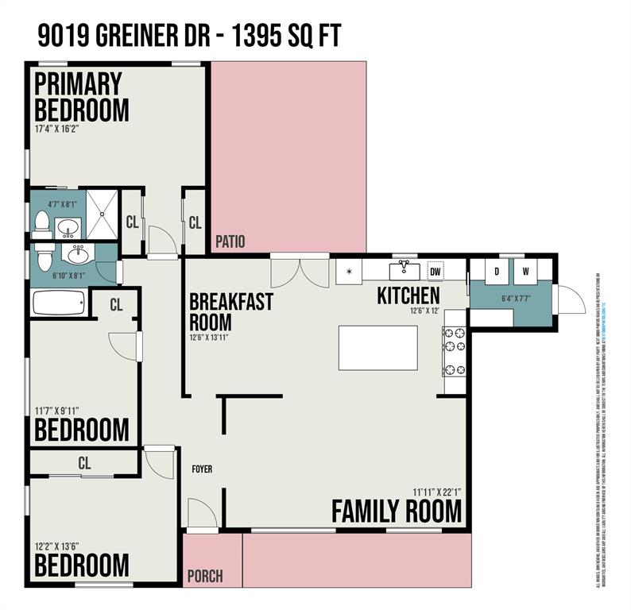
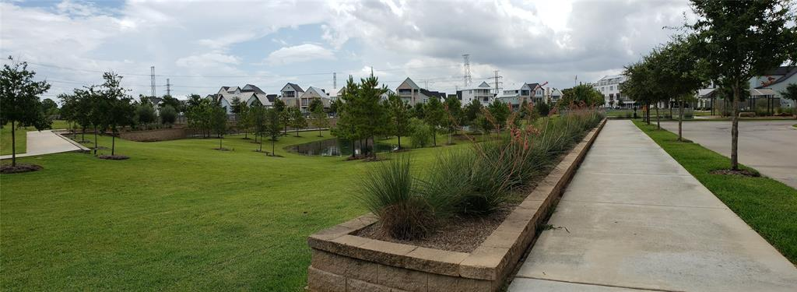
Image Classification
Using a pre-trained model (https://omidpoursaeed.github.io/publication/vision-based-real-estate-price-estimation/)
90% accuracy
7 different categories (bathroom, bedroom, living room, exterior, kitchen, dining room and interior)
Bathroom
Bedroom
Exterior
Living Room
Living Room
Bathroom
Bedroom
Interior

Slide 12
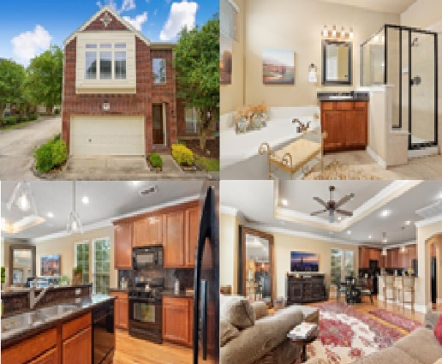
Regression model using CNN
Randomly select 4 images (bathroom, exterior, kitchen, living room)
Combined as one image for each house
CNN
Median Error 33.71%
Median Absolute Error $109,041

Slide 13
Ensemble Model
Lot Size
MLP
Building Sqft
living Sqft
Combined Model
kitchen Sqft
No. of Garage
CNN
Median Error 8.1%
Median Absolute Error $27,292

Slide 14

Conclusion
Appearance has impact on the value of residential properties
Train on large dataset will show better results
Image classification important
Using Purchased price

Slide 15
Thank You

